Slide 1
HEART DISEASE CLASSIFICATION
SANSKRITI PATOLE & STUTI JANI

Slide 2
Problem Statement and Motivation
“Efficient Prediction of Cardiovascular disease by utilizing classification techniques ”
Motivation:
Cardiovascular diseases are one of the biggest reason for death worldwide. It accounts for about 35% of total deaths worldwide. Early detection of the disease will prove to be one of the ways to salvage people. Clinically, it is critical and sensitive for the signs of heart disease for accurate forecasts and concrete steps for future diagnosis. Building a machine learning model is a cost effective and scalable way to achieve this.

Slide 3
Objective
To effectively predict if a patient has cardiovascular disease or not
To use machine learning algorithms to deduce the result.
Comparing between algorithms and analysing the efficacy of the algorithms.
To minimise the cost of expensive manual, clinical processes while using machine learning model

Slide 4
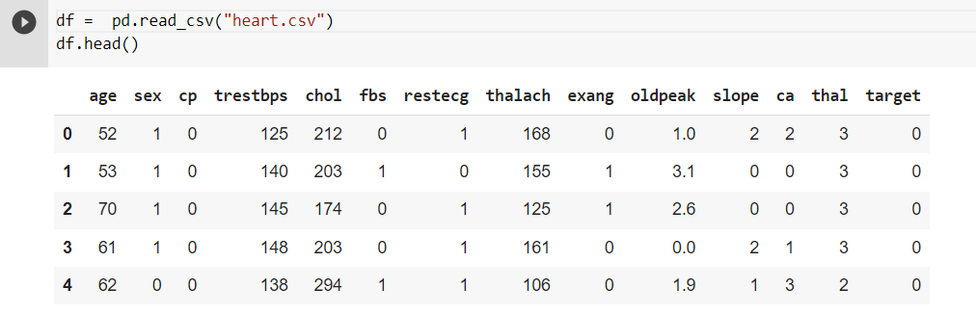
DataSet

Slide 5
Data contains;
age - age in years
sex - (1 = male; 0 = female)
cp - chest pain type
trestbps - resting blood pressure (in mm Hg on admission to the hospital)
chol - serum cholesterol in mg/dl
fbs - (fasting blood sugar > 120 mg/dl) (1 = true; 0 = false)
restecg - resting electrocardiographic results
thalach - maximum heart rate achieved
exang - exercise induced angina (1 = yes; 0 = no)
oldpeak - ST depression induced by exercise relative to rest
slope - the slope of the peak exercise ST segment
ca - number of major vessels (0-3) colored by fluoroscopy
thal - 3 = normal; 6 = fixed defect; 7 = reversible defect
target - have disease or not (1=yes, 0=no)

Slide 6
Approach
Data Collection
Data Exploration
Model for Logistic Regression
Fetch Datasets from the relevant locations
Visualize the data using bar graphs and scatterplots.
Training the model for logistic regression
Comparing Models
Support Vector Machine
K-Nearest-
Neighbour
Confusion Matrix
Applying SVM algorithm on the dataset
Applying KNN algorithm on the dataset.

Slide 7
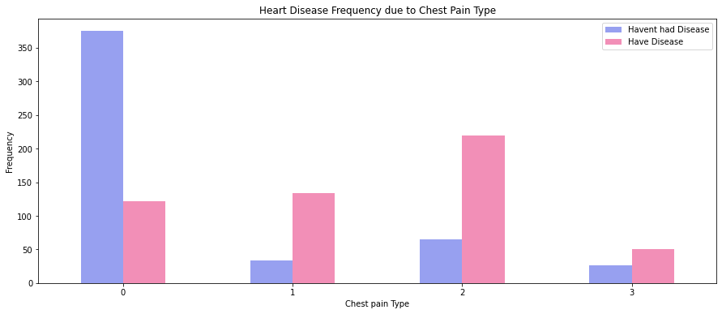
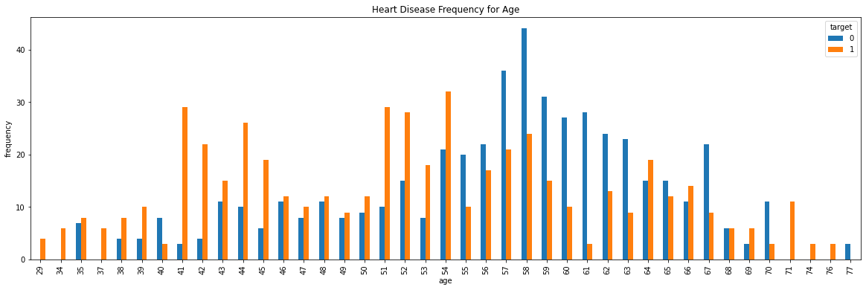
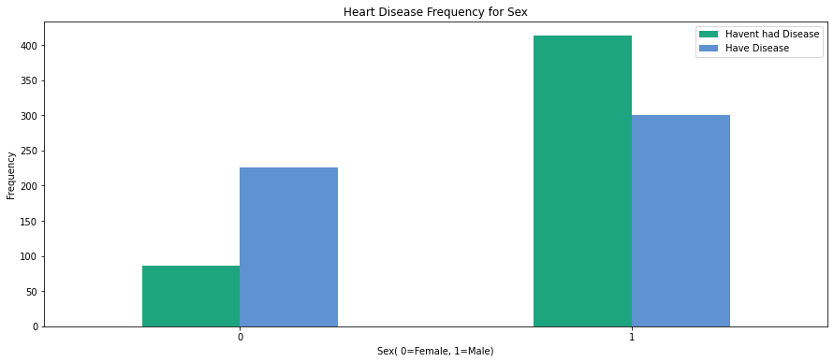
Data Visualization

Slide 8
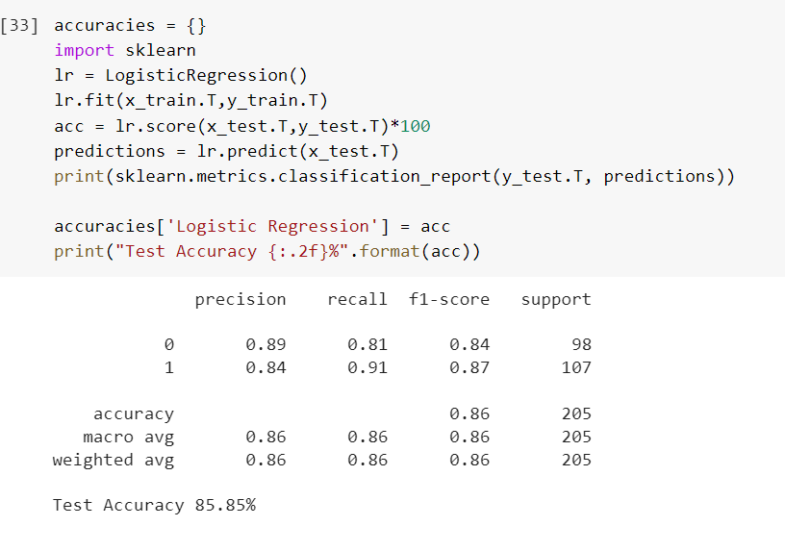
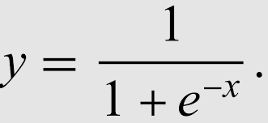
Algorithm
LOGISTIC REGRESSION:
It is a binary classification technique used to classify whether a person has Heart Disease or not.
It uses sigmoid function which takes real input x and predicts output probability between range 0-1.
If P(x) >50% then, output Y= 1
Maximum Likelihood is used to estimate the parameters of Logistic regression model.
The test accuracy of Logistic Regression model for our project is 85.85% (using sklearn)
But when performed manually the Test accuracy is 86.34%

Slide 9
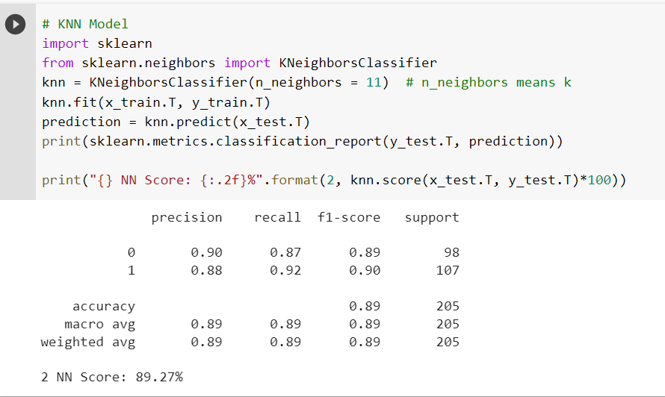
Algorithm
K-NEAREST NEIGHBOUR
The k-nearest neighbors algorithm, also known as KNN or k-NN, is a non-parametric, supervised learning classifier, which uses proximity to make classifications or predictions about the grouping of an individual data point.
The formula used for calculating the distance using Euclidean , Manhattan and Minkowski techniques.
We are using Euclidean algorithm for our KNN classification
d=√((x2-x1)²+(y2-y1)²)
The test accuracy of Logistic Regression model for our project is 89.27%

Slide 10
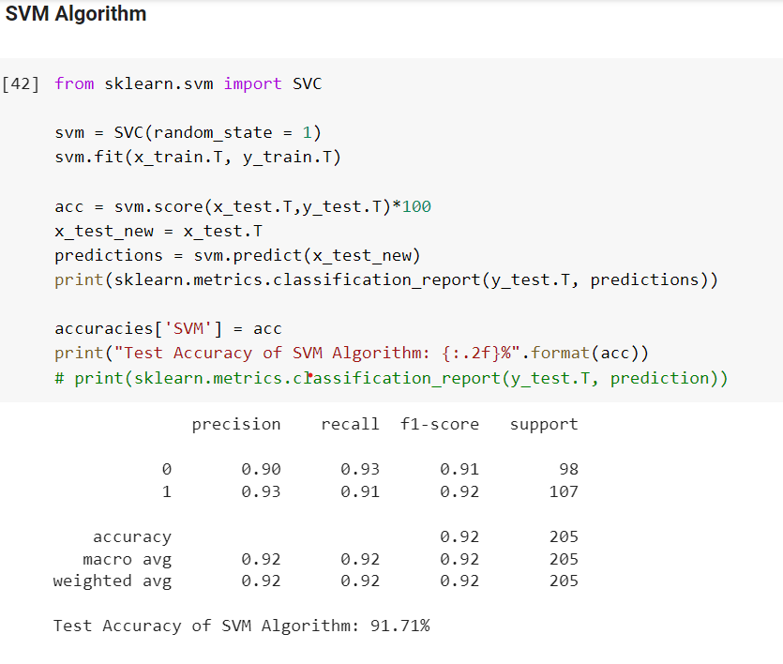
Algorithm
SUPPORT VECTOR MACHINE
The objective of the support vector machine algorithm is to find a hyperplane in an N-dimensional space(N — the number of features) that distinctly classifies the data points.
When performed manually the Test accuracy is 91.71%

Slide 11
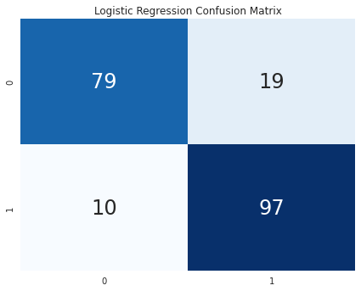
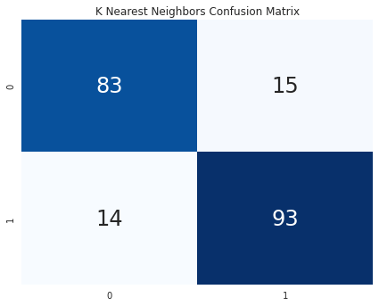
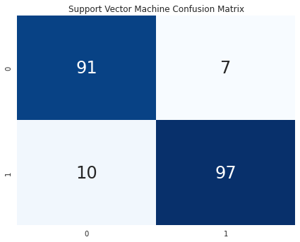
Algorithm Selection
F1 Score | 0.86
Accuracy | 85.85%
Recall | 0.86
Precision | 0.86
F1 Score | 0.89
Accuracy | 89.27%
Recall | 0.89
Precision | 0.89
F1 Score | 0.92
Accuracy | 91.71%
Recall | 0.92
Precision | 0.92

Slide 12
Conclusion
THE BEST ALGORITHM IS :
After comparing between the 3 classification techniques , the best accuracy is given by Support vector machine at 91.71%
Link to project:
COEN_240_Final_Project

